Slide 1
Projects Better Together: Text + Context
Kenneth Church
Wednesday, June 26
https://github.com/kwchurch/JSALT_Better_Together

Slide 2
Overview
Evaluation
Bad Benchmarks: CIKM
More promising: G over time
Summarization
Do not summarize docs one at a time
Compare & Contrast Clusters
Inverse BERT
Citing Sentences:
Why is a paper important to contemporary audience in contemporary terms?
Approximate Nearest Neighbors
External memory (mmap)
Cannot materialize M*M^T
But can find large values
Similarities of Groups of Docs
Venues, Authors, etc
Systems (ProNE)

Slide 3
Summarization of 348 Docs
348 Docs
See here

Slide 4
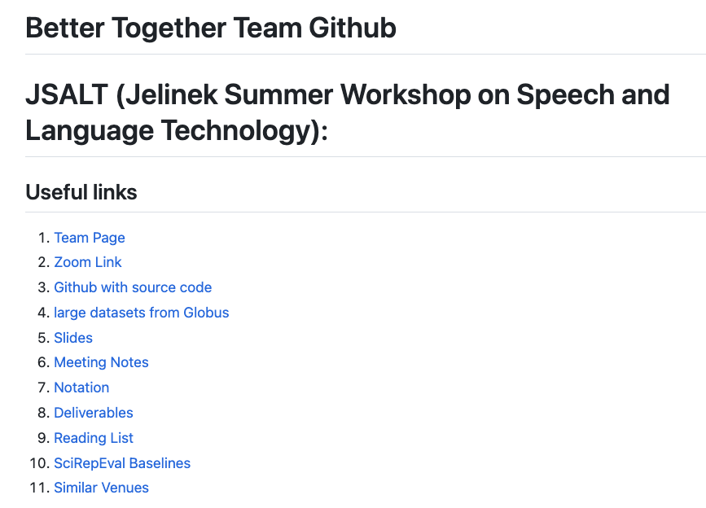
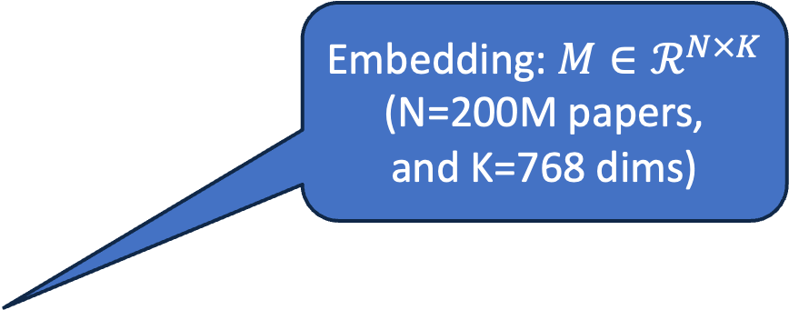
https://github.com/kwchurch/JSALT_Better_Together
Embedding: $M∈ℛ^{N×K}$
(N=200M papers,
and K=768 dims)
including these slides

Slide 5

Better Together: Text (Titles, Abstracts, Body); Context (Citations)

Slide 6
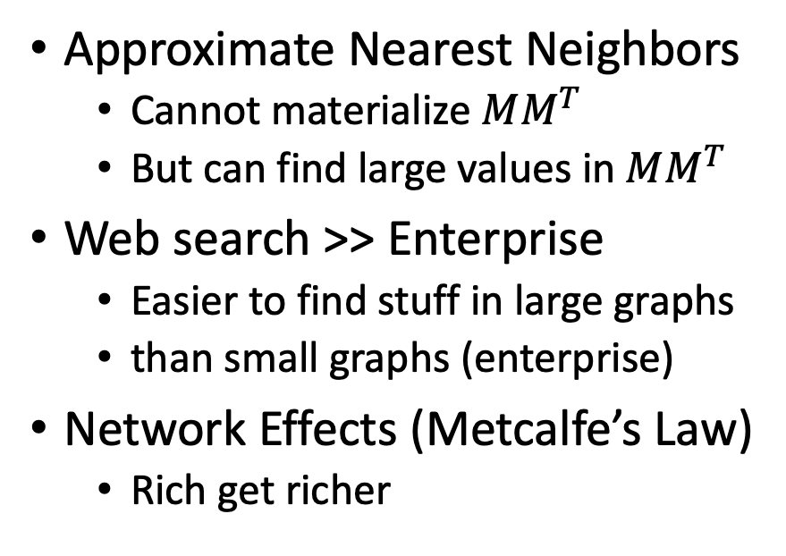
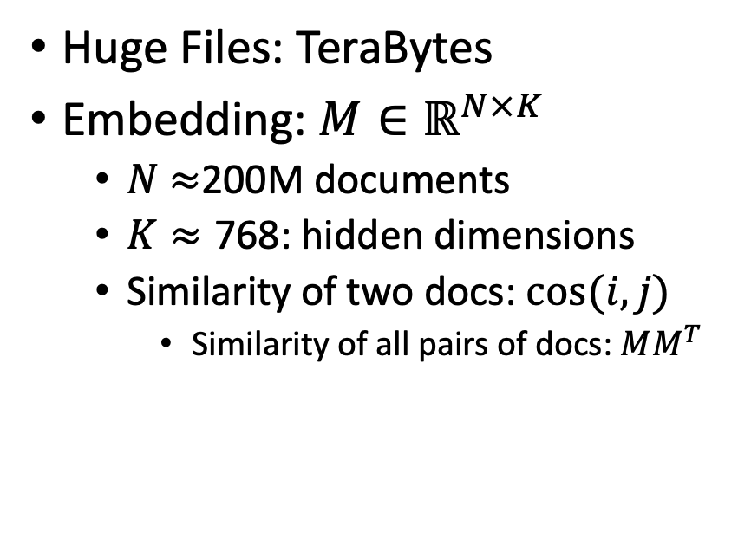
Scale: Both a Blessing and a Curse
Curse
Blessing
Huge Files: TeraBytes
Embedding: $M∈ℝ^{N×K}$
$N$ $≈$200M documents
$K≈\text{768}$: hidden dimensions
Similarity of two docs: $cos(i,j)⁡$
Similarity of all pairs of docs: $MM^{T}$
Approximate Nearest Neighbors
Cannot materialize $MM^{T}$
But can find large values in $MM^{T}$
Web search >> Enterprise
Easier to find stuff in large graphs
than small graphs (enterprise)
Network Effects (Metcalfe’s Law)
Rich get richer

Slide 7


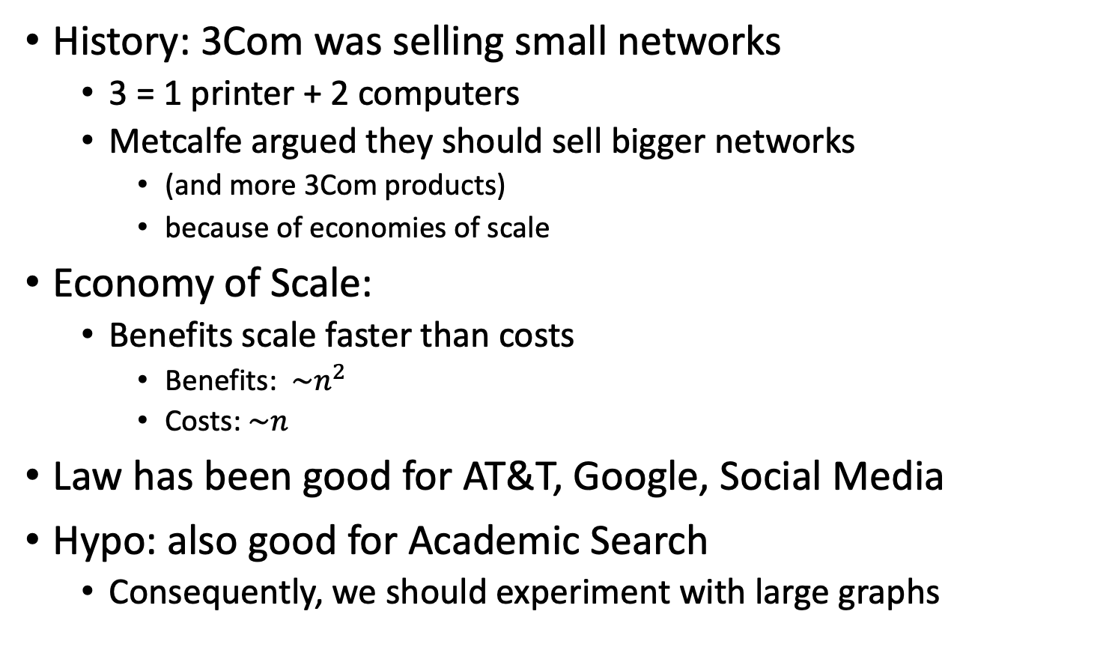
Metcalfe’s Law (Network Effects)
History: 3Com was selling small networks
3 = 1 printer + 2 computers
Metcalfe argued they should sell bigger networks
(and more 3Com products)
because of economies of scale
Economy of Scale:
Benefits scale faster than costs
Benefits: $\sim n^{2}$
Costs:$\sim n$
Law has been good for AT&T, Google, Social Media
Hypo: also good for Academic Search
Consequently, we should experiment with large graphs

Slide 8
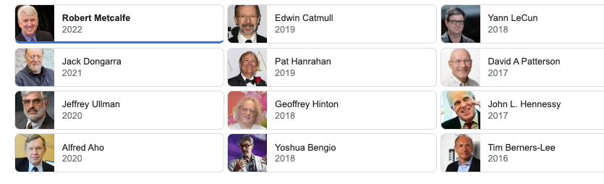
Turing Award/Winners

Slide 9
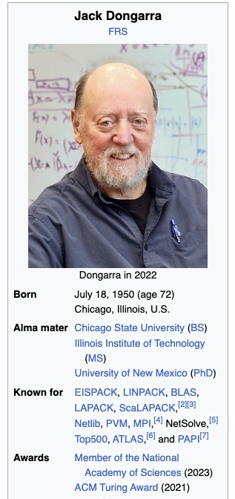
Turing Awards: Metcalfe’s Law, Deep Nets, Linear Algebra
Metclalfe’s Law: Metcalfe
Deep Nets: Hinton, Bengio, LeCun
Linear Algebra: Dongarra

Slide 10
Realities
The Real World
Idealizations (Evaluation Benchmarks)
Large (Metcalfe’s Law)
Growing
Dirty
Missing Values
Bad/misleading Values
Small
Static
Clean

Slide 11
Global Scientific Output Doubles Every 9 Years
Timeliness
Web companies keep indexes up to date (web is a moving target)
Ditto for Academic Search

Slide 12
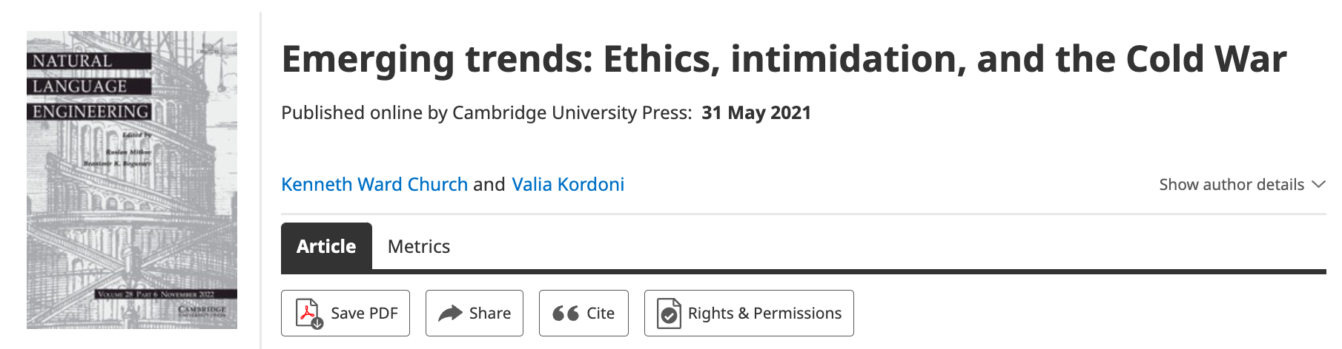
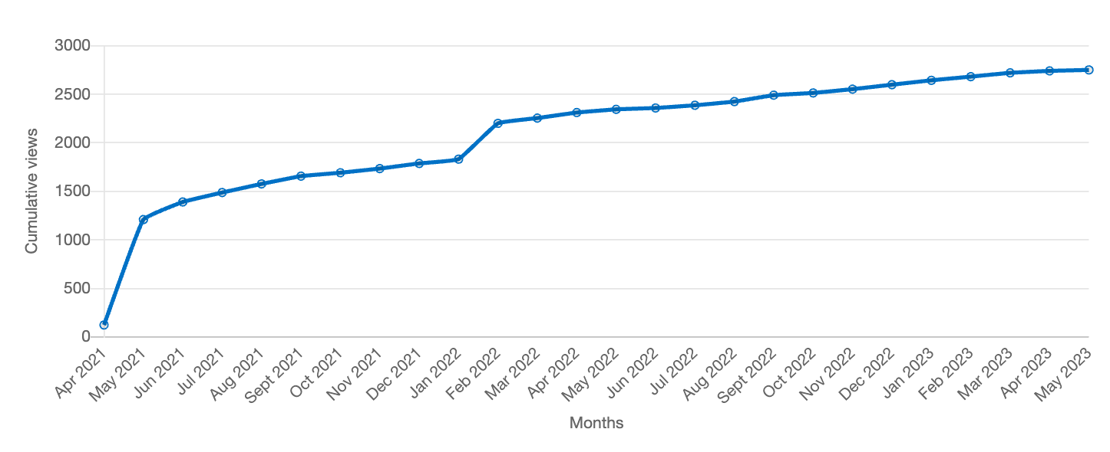
Value: Author Contributions + Audience Appreciation (Literature is a conversation, like social media)
Author Contributions
Time Invariant
Does not change after publication
Audience Appreciation
Evolves over time
Behavioral Signals
Views
Citations

Slide 13
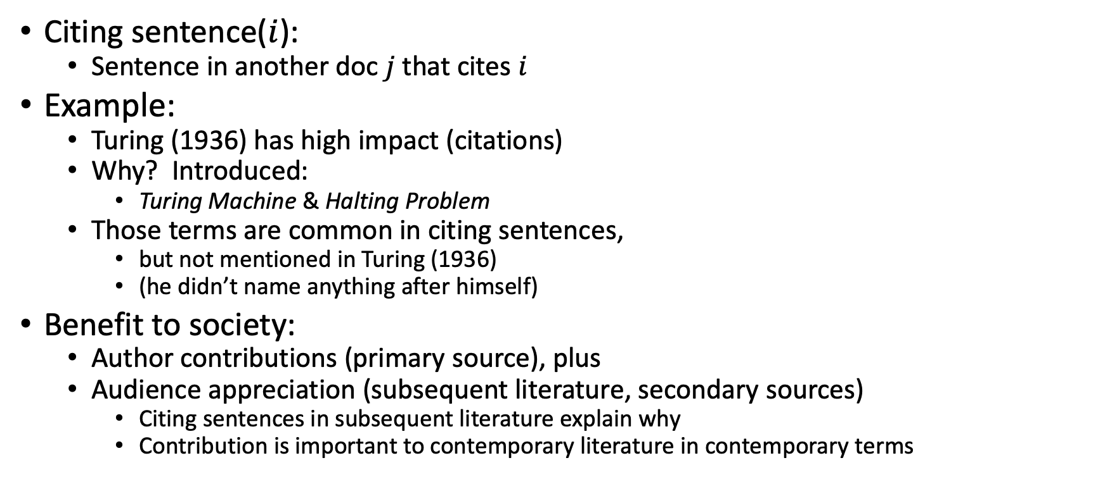
Citing Sentences
Citing sentence($i$):
Sentence in another doc $j$that cites $i$
Example:
Turing (1936) has high impact (citations)
Why? Introduced:
Turing Machine & Halting Problem
Those terms are common in citing sentences,
but not mentioned in Turing (1936)
(he didn’t name anything after himself)
Benefit to society:
Author contributions (primary source), plus
Audience appreciation (subsequent literature, secondary sources)
Citing sentences in subsequent literature explain why
Contribution is important to contemporary literature in contemporary terms
Anchor Text in Web Search

Slide 14
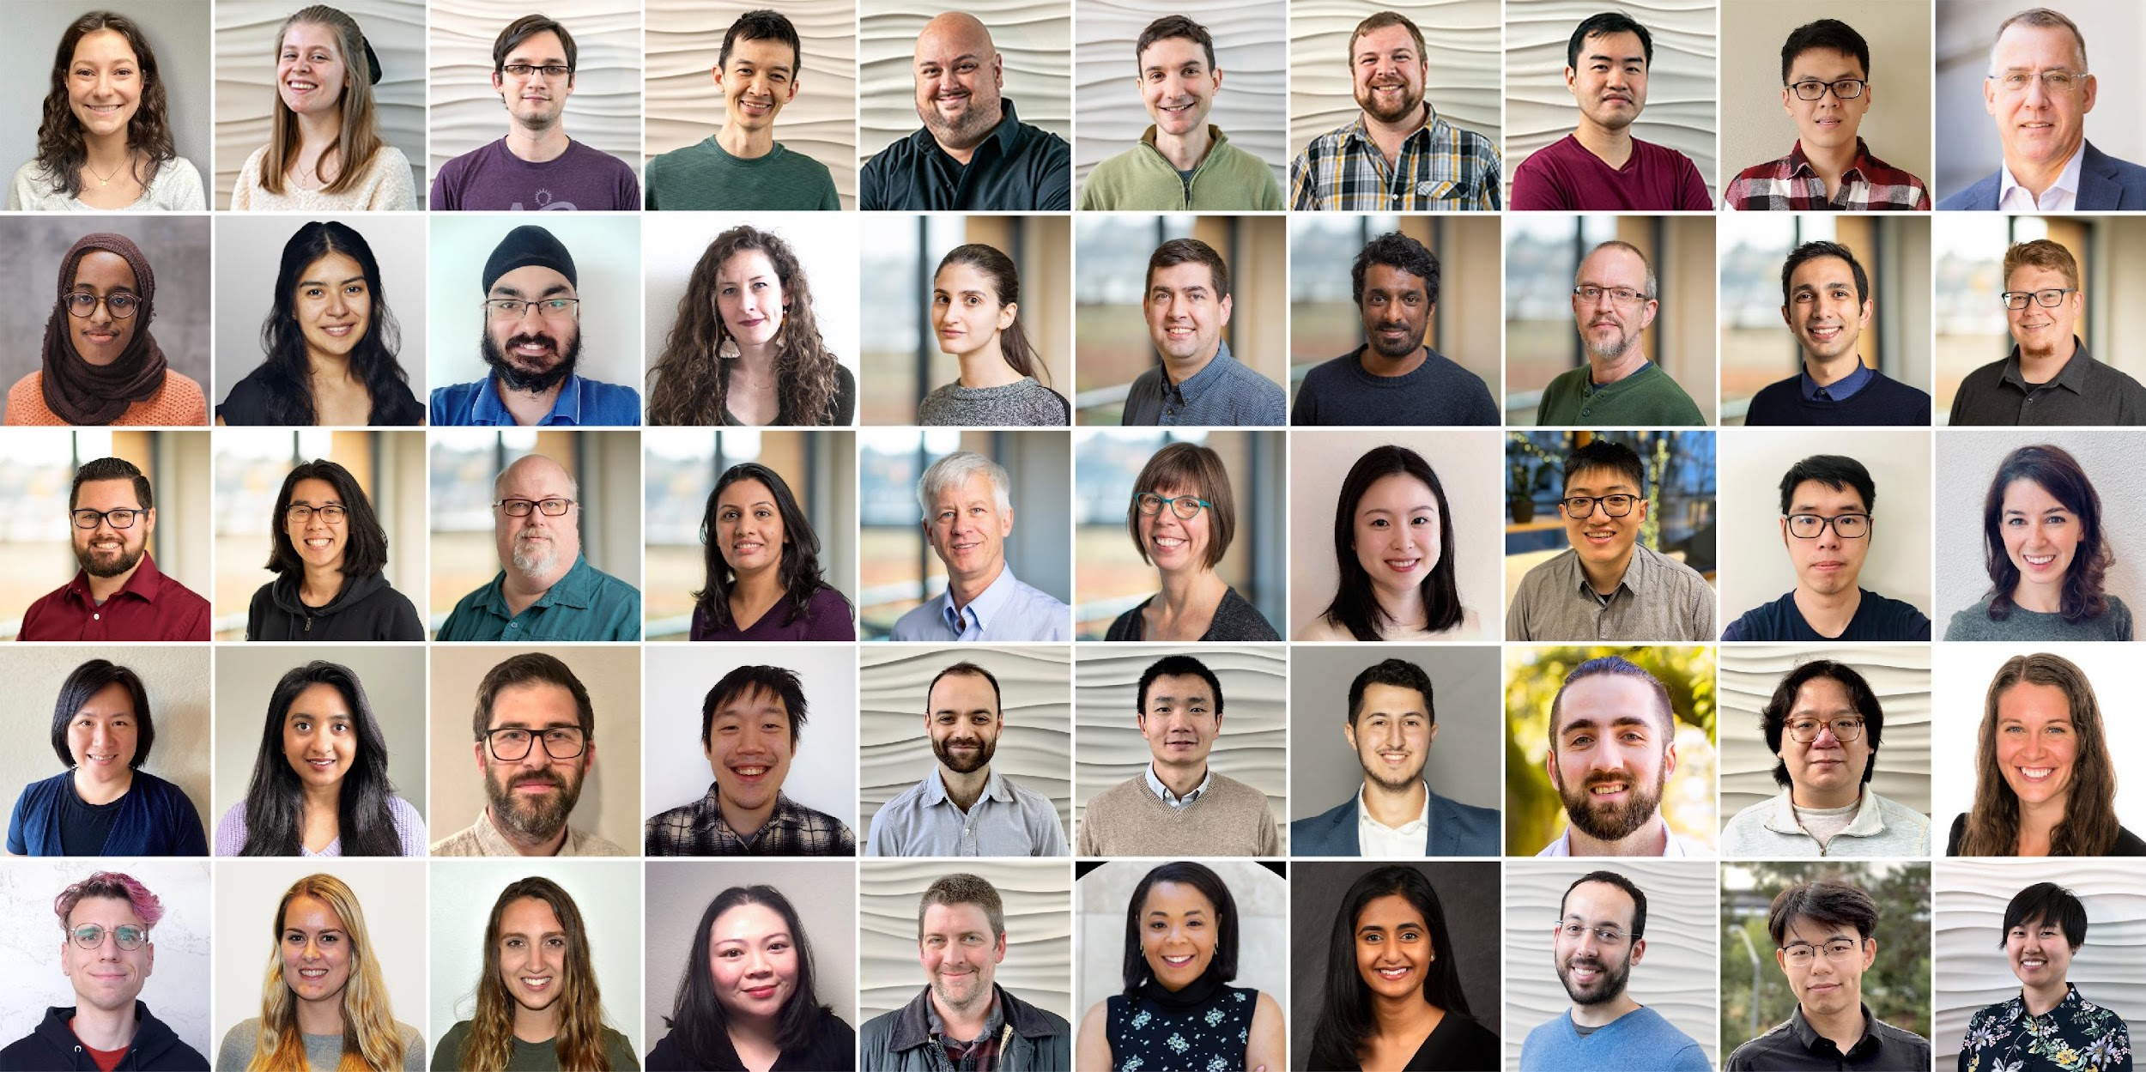
Semantic Scholar: Significant Effort (slide from Dan Weld)
50 person team
7 year project
207M+ scientific paper index
8M+ monthly active users

Slide 15
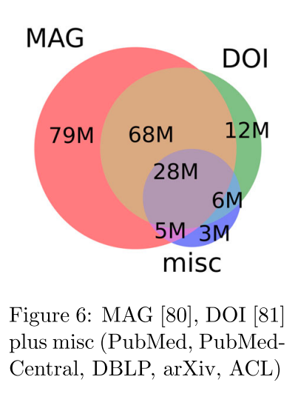
Semantic Scholar
Seven Sources
Fields of Study
Medicine (45M) | Engineering (8M) | Business (4M) | Geology (3M)
Chemistry (13M) | Physics (7M) | Sociology (3M) | History (2M)
Computer Science (13M) | Psychology (7M) | Geography (3M) | Art (2M)
Biology (13M) | Mathematics (5M) | Economics (3M) | Philosophy (1M)
Materials Science (10M) | Political Science (4M) | Environmental Science (3M)

Slide 16



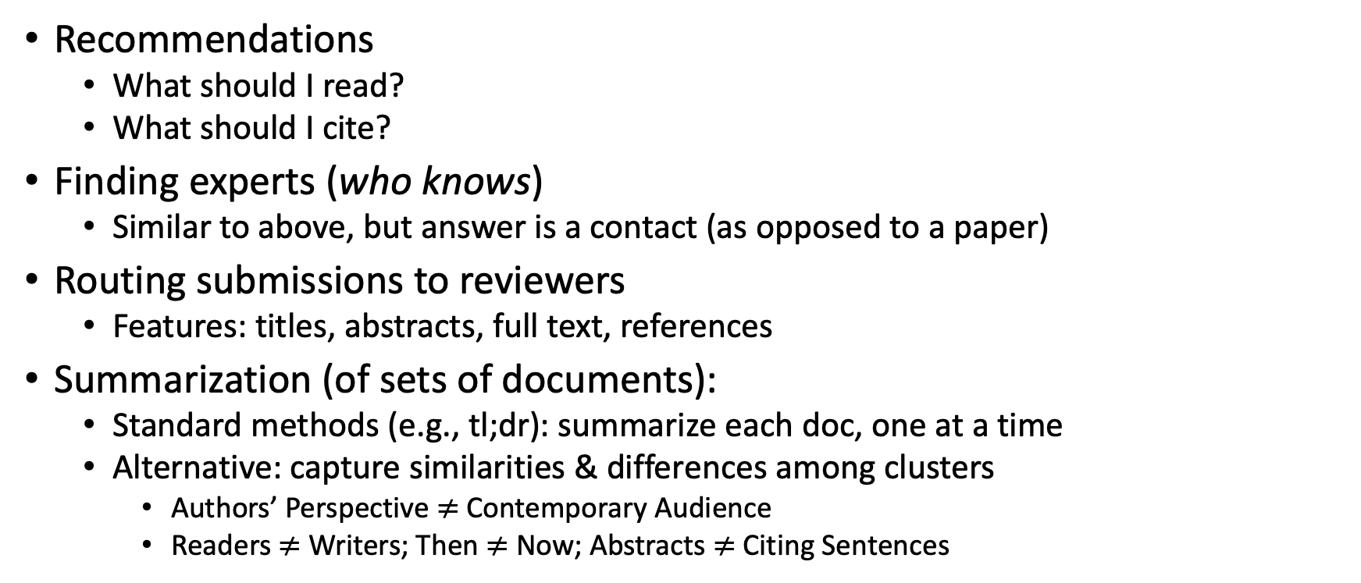
Document Similarities: Use Cases
Recommendations
What should I read?
What should I cite?
Finding experts (who knows)
Similar to above, but answer is a contact (as opposed to a paper)
Routing submissions to reviewers
Features: titles, abstracts, full text, references
Summarization (of sets of documents):
Standard methods (e.g., tl;dr): summarize each doc, one at a time
Alternative: capture similarities & differences among clusters
Authors’ Perspective $≠$Contemporary Audience
Readers $≠$ Writers; Then $≠$ Now; Abstracts $≠$ Citing Sentences

Slide 17
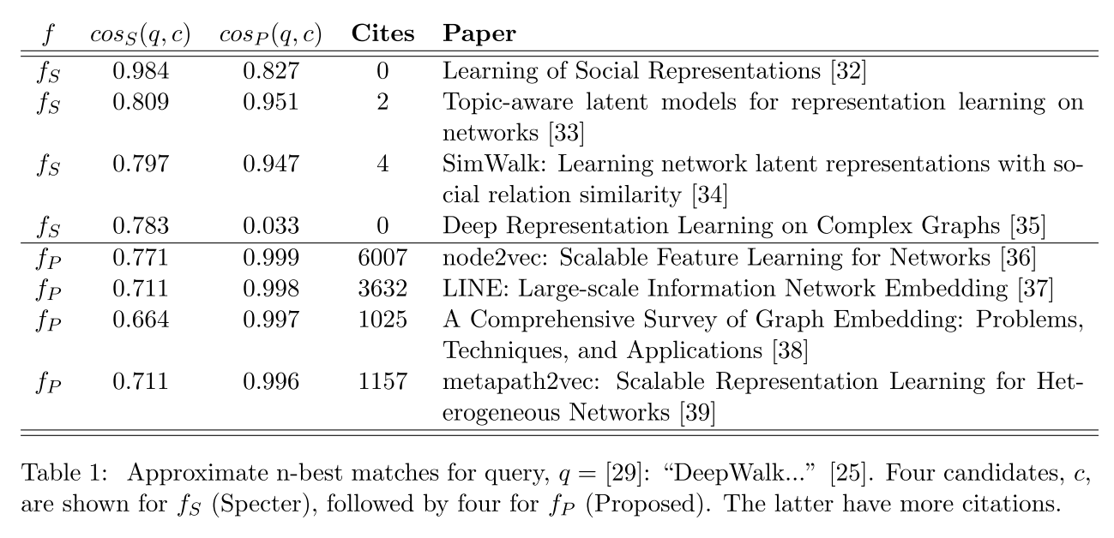
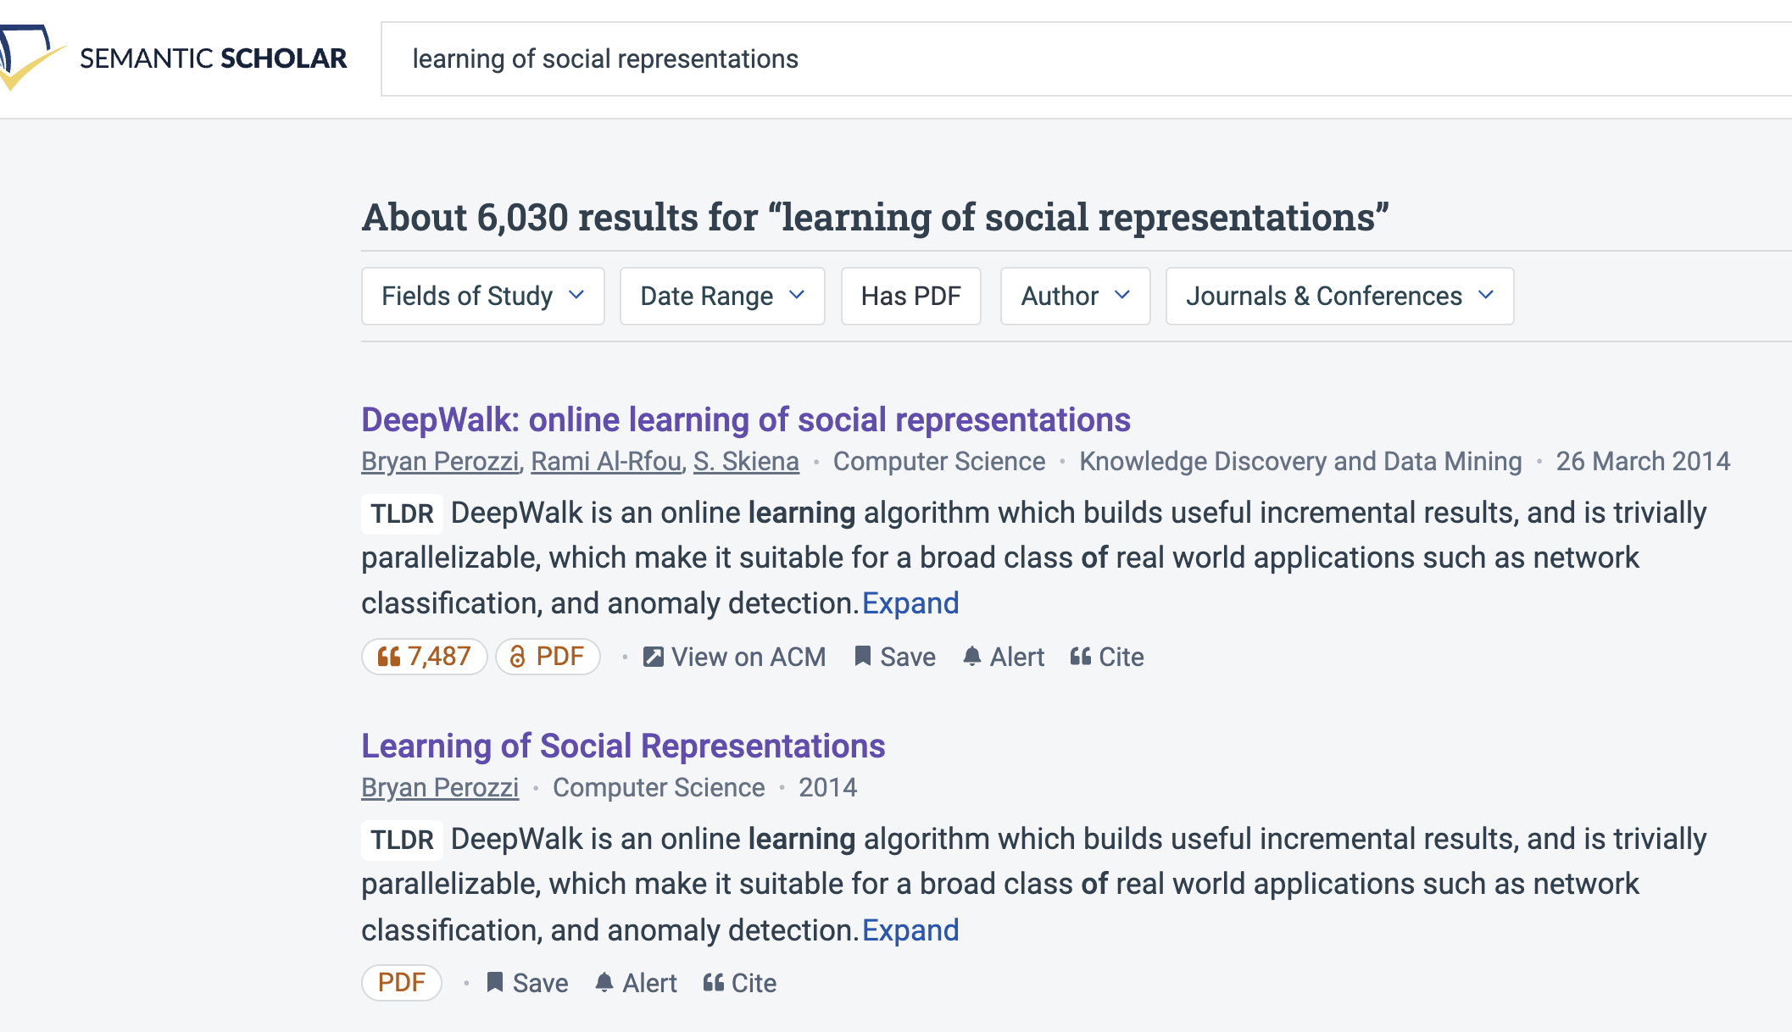
Query: ``DeepWalk: Online Learning of…’’

Slide 18
Document Similarities: Use Cases
Recommendations
What should I read?
What should I cite?
Many systems focus on ``relevance’’ (word overlap)
But we also want credibility
Don’t recommend papers that are buzz-word compliant
But not worth reading
(Most papers are never cited)

Slide 19
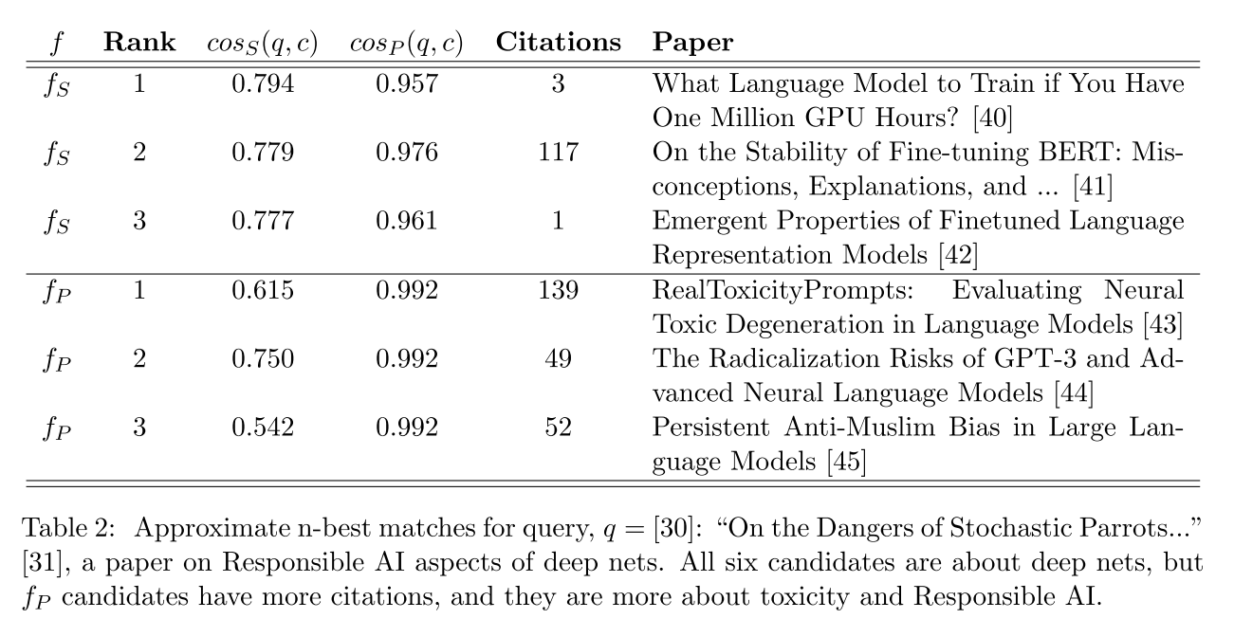
Query: ``On the Dangers of Stochastic Parrots…’’

Slide 20
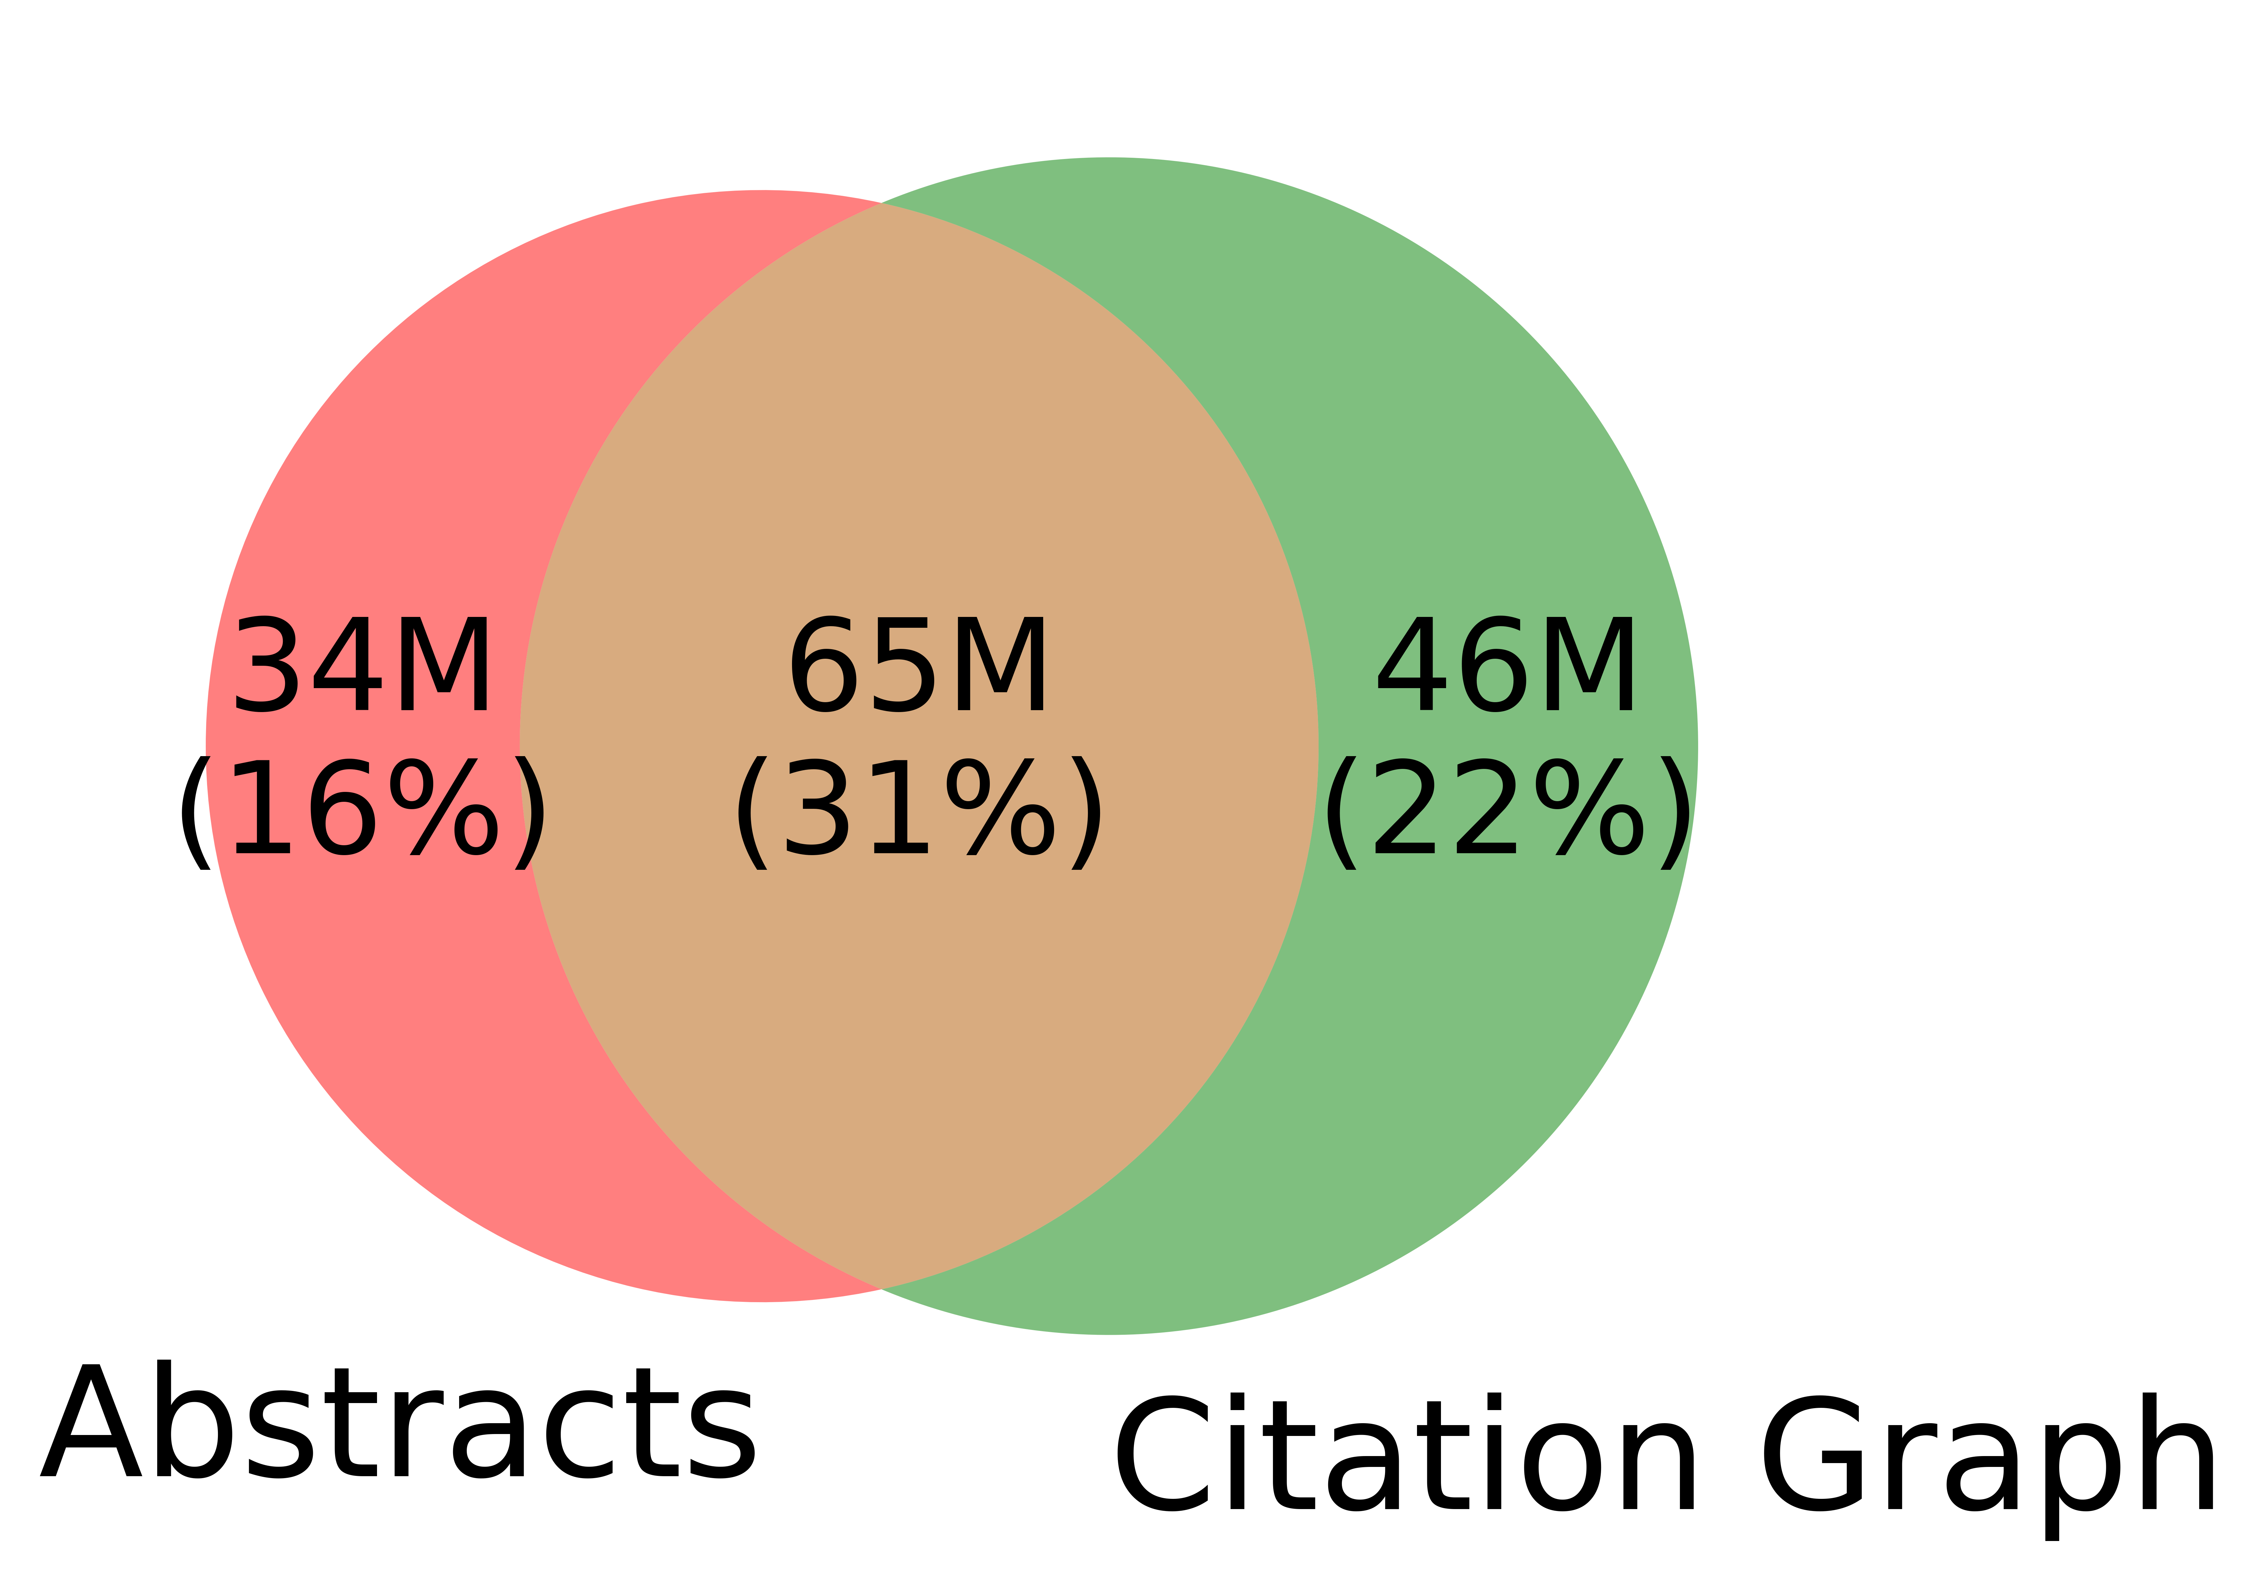
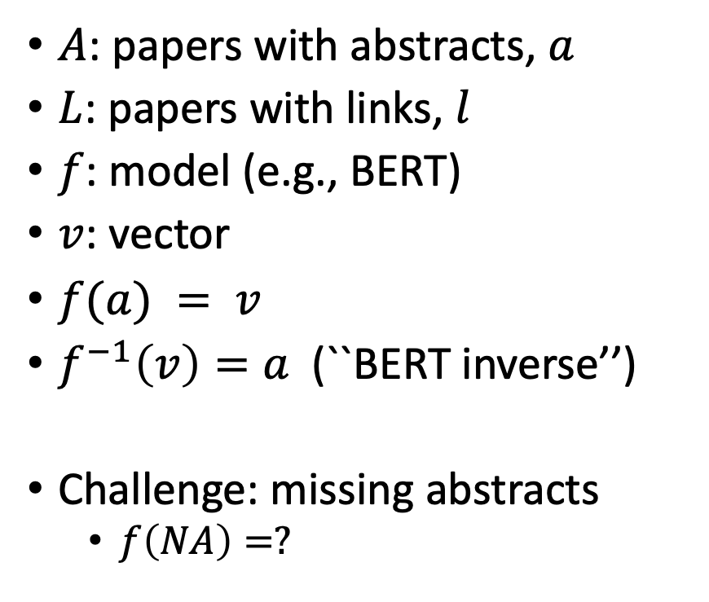
Realities: Missing Values
$A$: papers with abstracts, $a$
$L$: papers with links, $l$
$f$: model (e.g., BERT)
$v$: vector
$f(a) = v$
$f^{−1}\left(v\right)=a$(``BERT inverse’’)
Challenge: missing abstracts
$f\left(NA\right)=?$

Slide 21
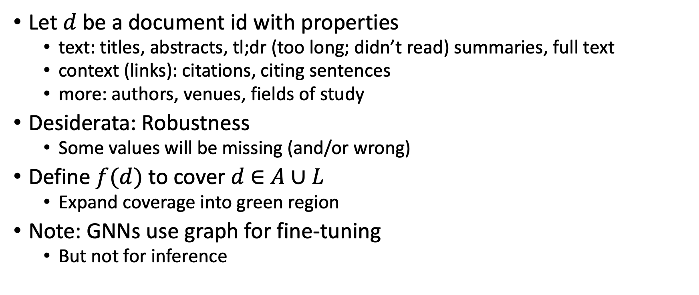
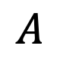
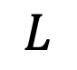
Suggestion for Missing Values
Let $d$ be a document id with properties
text: titles, abstracts, tl;dr (too long; didn’t read) summaries, full text
context (links): citations, citing sentences
more: authors, venues, fields of study
Desiderata: Robustness
Some values will be missing (and/or wrong)
Define $f(d)$ to cover $d$ $∈$ $A∪L$
Expand coverage into green region
Note: GNNs use graph for fine-tuning
But not for inference
$$A$$
$$L$$

Slide 22
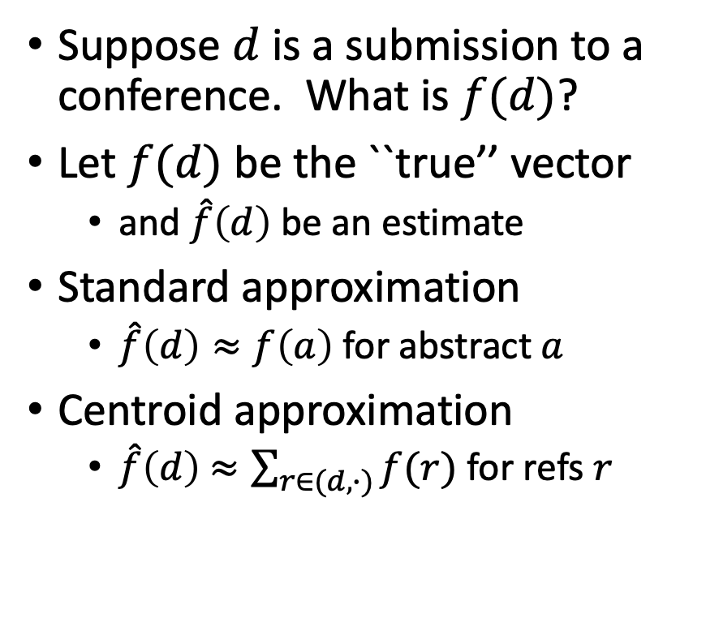
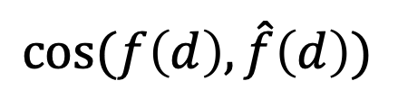
Centroid Assumption
Evidence for Centroid Approximation
Suppose $d$ is a submission to a conference. What is $f(d)$?
Let $f(d)$ be the ``true’’ vector
and $\hat{f}\left(d\right)$ be an estimate
Standard approximation
$\hat{f}\left(d\right)≈f\left(a\right)$ for abstract $a$
Centroid approximation
$\hat{f}\left(d\right)$ $≈\sum_{r∈(d,∙)}{f(r)}$ for refs $r$
$$cos⁡(f\left(d\right), \hat{f}\left(d\right))$$

Slide 23
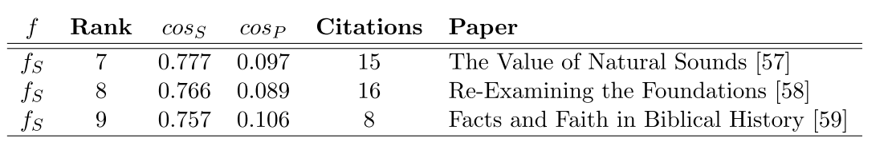
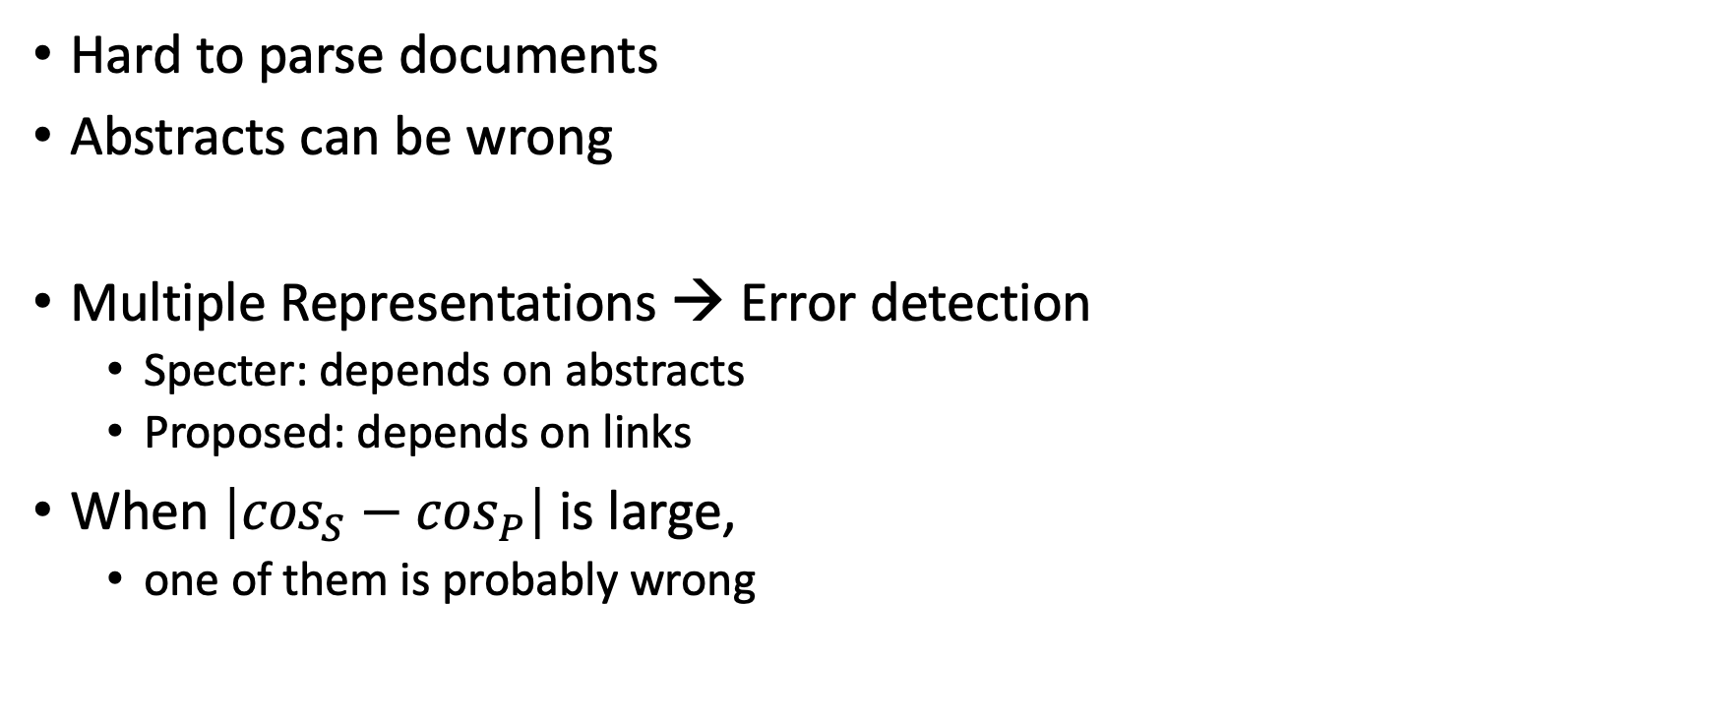
Bad/Misleading Values: Redundancy → Robustness
Hard to parse documents
Abstracts can be wrong
Multiple Representations → Error detection
Specter: depends on abstracts
Proposed: depends on links
When $\left|\cos_{S}−\cos_{P}\right|$is large,
one of them is probably wrong

Slide 24


Rank | Specter | Proposed | Paper
query | 1.000 | 1.000 | 1097: On stress and linguistic rhythm
1 | 0.908 | 0.926 | 0: Linguistic Society of America Structure and Intonation
2 | 0.895 | 0.977 | 475: Preliminaries to linguistic phonetics
3 | 0.885 | 0.921 | 25: Linguistic Society of America On the Definition of Word by
4 | 0.881 | 0.763 | 37: On some defferences between Chinese and Japanese '-Wh'-elements
5 | 0.880 | 0.946 | 2: Some accentuation properties in Japanese and lexical phonology
6 | 0.865 | 0.824 | 6: Two Types of Zi-Verbs in Japanese
7 | 0.777 | 0.097 | 15: The Value of Natural Sounds
8 | 0.766 | 0.089 | 16: Re-Examining the Foundations
9 | 0.757 | 0.106 | 8: Facts and Faith in Biblical History
1 | 0.578 | 0.998 | 226: The phonology of rhythm in English
2 | 0.530 | 0.997 | 74: A grid-based theory of English meter
3 | -1.000 | 0.996 | 5: "What does Phonology tell us about Stress and Rhythm? Some Reflections on the Phonology of Stress"
4 | 0.460 | 0.994 | 1: Syllable structure and stress in Bahdinani Kurdish
5 | 0.442 | 0.994 | 35: Schwa in phonological theory
6 | -1.000 | 0.994 | 163: The Sound Pattern of Russian: A Linguistic and Acoustical Investigation
7 | 0.542 | 0.993 | 27: Empirical evidence for a deletion formulation of the rhythm rule in English
8 | 0.552 | 0.993 | 95: Prosodic Structure Above the Word
9 | 0.334 | 0.993 | 0: Syllable Contraction in Cantonese A-not-A Constructions: An Optimality Account

Slide 25
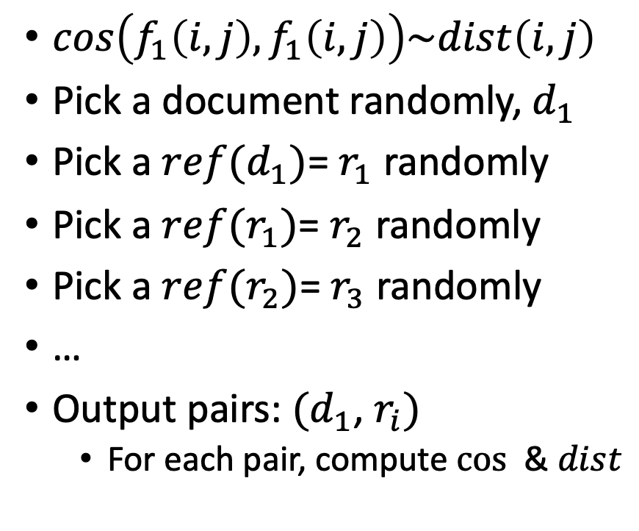
Random Walks
$cos\left(f_{1}\left(i, j\right),f_{1}\left(i, j\right)\right)\sim dist\left(i,j\right)$
Pick a document randomly, $d_{1}$
Pick a $ref(d_{1})$= $r_{1}$ randomly
Pick a $ref(r_{1})$= $r_{2}$ randomly
Pick a $ref(r_{2})$= $r_{3}$ randomly
…
Output pairs: $(d_{1}$, $r_{i})$
For each pair, compute $cos⁡$ & $dist$

Slide 26
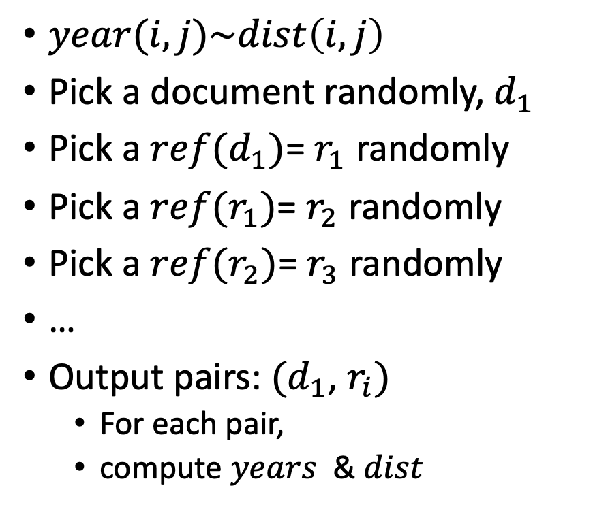
Random Walks
$year(i,j)\sim dist\left(i,j\right)$
Pick a document randomly, $d_{1}$
Pick a $ref(d_{1})$= $r_{1}$ randomly
Pick a $ref(r_{1})$= $r_{2}$ randomly
Pick a $ref(r_{2})$= $r_{3}$ randomly
…
Output pairs: $(d_{1}$, $r_{i})$
For each pair,
compute $years⁡$ & $dist$

Slide 27
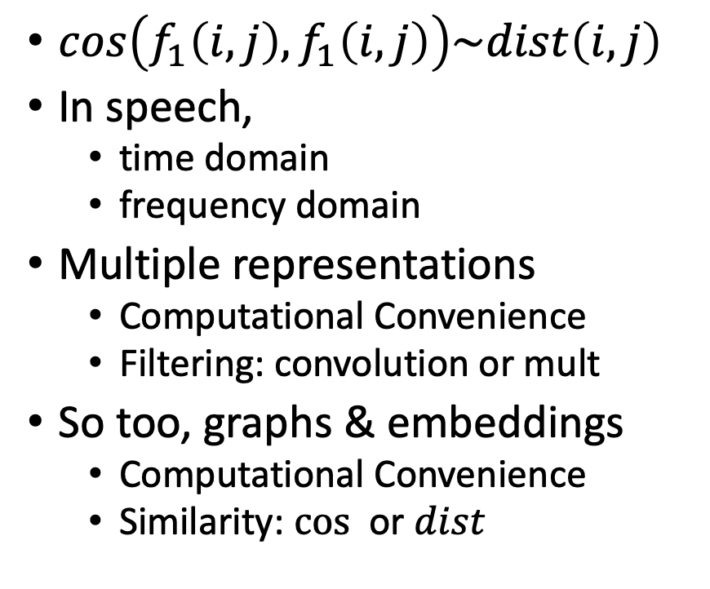
Cos-Dist: Multiple Views of Similarity
$cos\left(f_{1}\left(i, j\right),f_{1}\left(i, j\right)\right)\sim dist\left(i,j\right)$
In speech,
time domain
frequency domain
Multiple representations
Computational Convenience
Filtering: convolution or mult
So too, graphs & embeddings
Computational Convenience
Similarity: $cos⁡$ or $dist$

Slide 28
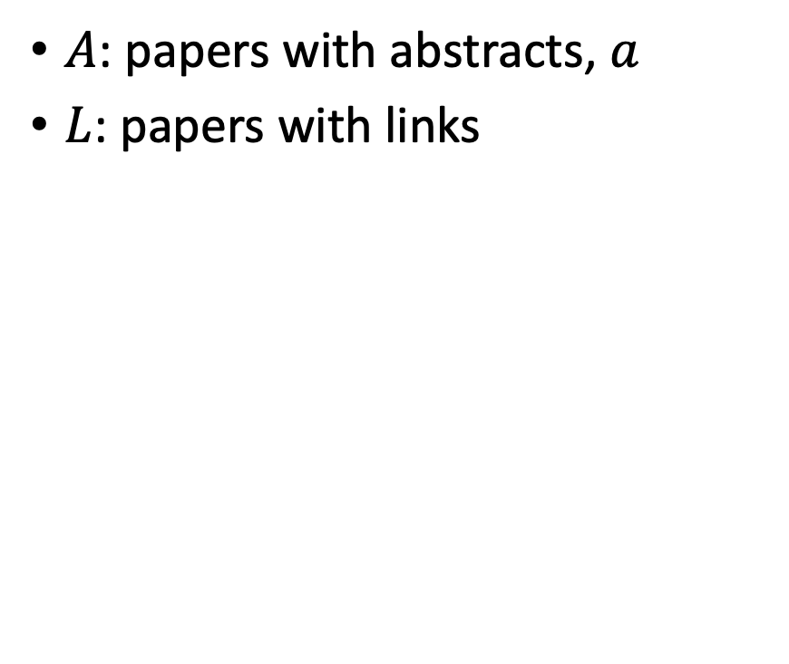
Realities: Missing Values
$A$: papers with abstracts, $a$
$L$: papers with links
Coverage | Pairs (Rand Walk) | Embedding
100% | 3,469,964 | Proposed
78% | 2,707,857 | Specter
35% | 1,216,506 | SciNCL
35% | 1,201,561 | Specter2
Standard Evaluations do not address coverage issues
API provides embeddings (but not abstracts)
for many papers

Slide 29
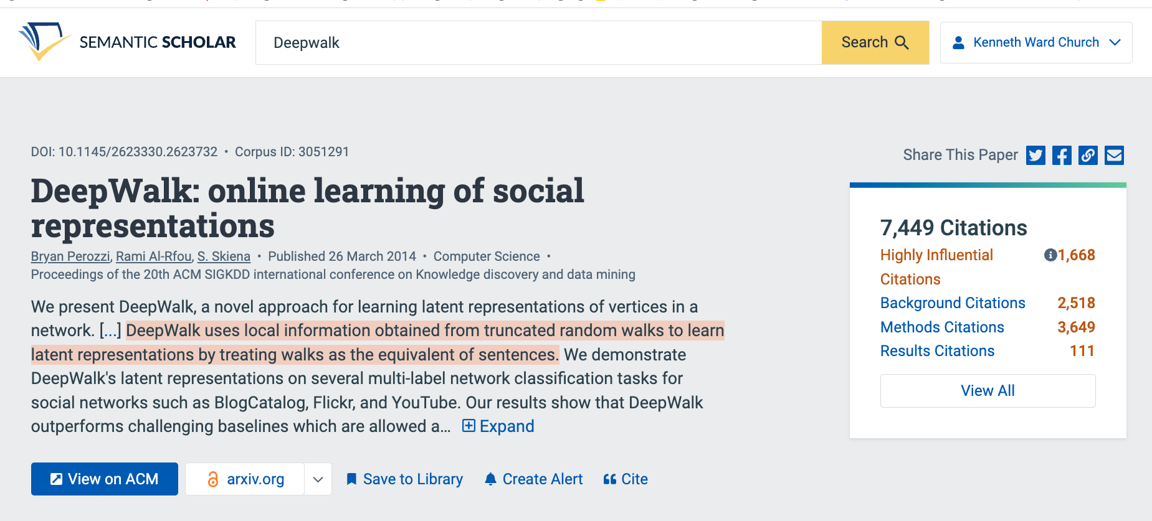
Summaries
Snippets
titles, authors, abstracts
tl;dr (too long; didn’t read)
Author Perspective:
These snippets
Audience Perspective:
Do these snippets capture 7k citations?
Why is this paper important
to contemporary readers?
Citing Sentences

Slide 30
Summarization Baselines
tl;dr
ChatGPT
⚠️ ⚠️ ⚠️ Warning ⚠️ ⚠️ ⚠️
Hallucinations

Slide 31
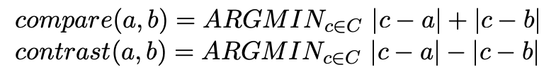
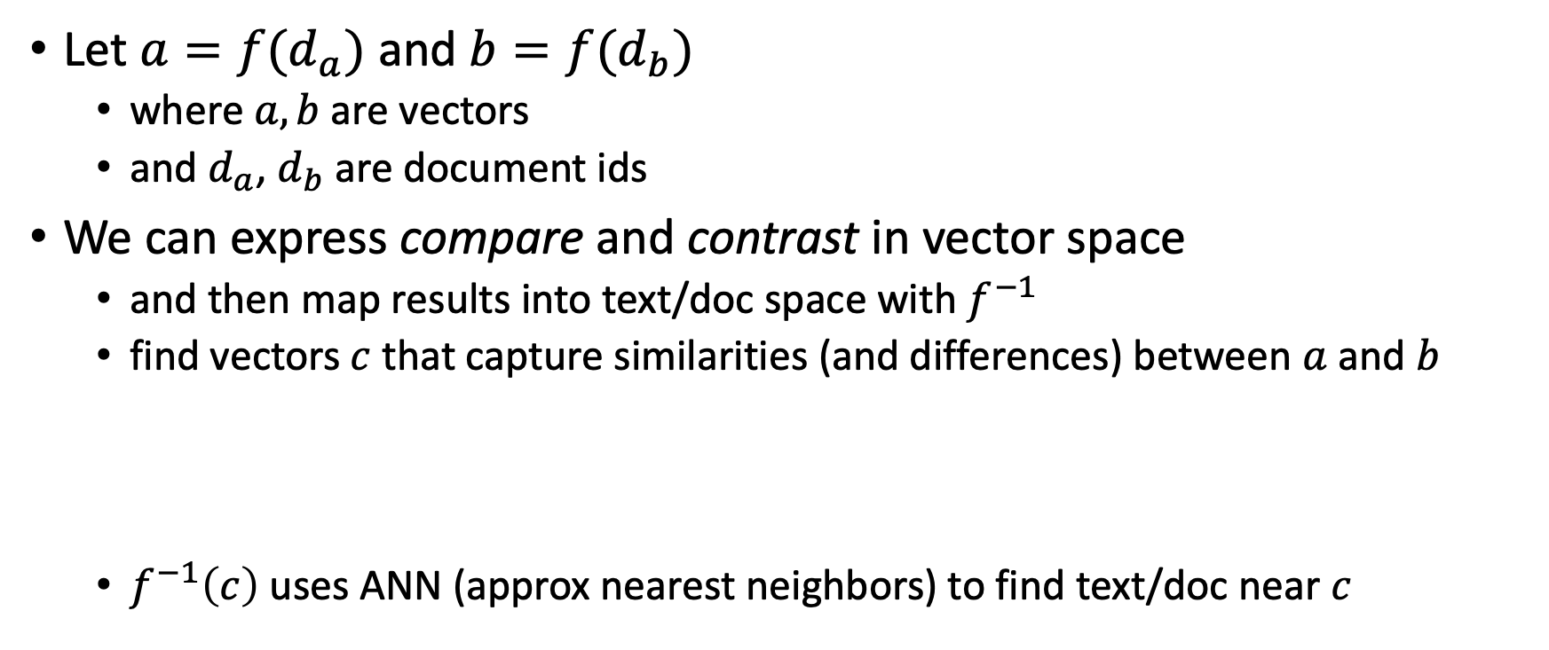
Summarization: Compare & Contrast (Do not summarize each doc, one at a time)
Let $a=f(d_{a})$ and $b=f(d_{b})$
where $a, b$are vectors
and $d_{a}$, $d_{b}$are document ids
We can express compare and contrast in vector space
and then map results into text/doc space with $f^{−1}$
find vectors $c$ that capture similarities (and differences) between $a$ and $b$
$f^{−1}\left(c\right)$ uses ANN (approx nearest neighbors) to find text/doc near $c$

Slide 32
Deliverables https://github.com/kwchurch/JSALT_Better_Together/blob/main/doc/deliverables.md
Better access to literature
Resources:
Many embeddings for many papers
Posted models on HuggingFace
Post code on GitHub
Summarization methods to compare and contrast across small (and large) collections of documents
Support incremental updates to embeddings based on citation graphs
Evaluation:
Better numbers,
as well as better benchmarks
Establish that combinations of text and links are better together (than either by itself)
Establish that citing sentences are useful
Improve methods for assigning papers to reviewers
Theory: Unified framework of
Deep nets and
Linear Algebra
Bibliometrics:
Predict citations of a paper over time.
Predict h-index of an author over time.
Find authors that publish too many papers

